Slide 1


FY2021-22 Budget Hearing
Presented to
Ways and Means Committee
January 6, 2021

Slide 2

Agency Attendees
Frank Rainwater, Executive Director
(803) 734-3786
Frank.Rainwater@rfa.sc.gov
Paul Athey, Division Director
(803) 734-3789
Paul.Athey@rfa.sc.gov
Carrie Bundrick, Finance Manager
(803) 734-3650
Carrie.Bundrick@rfa.sc.gov
Sandra Kelly, Strategic Operations Manager
(803) 898-9958
Sandra.Kelly@rfa.sc.gov

Slide 3
Organizational Structure
Governor
General Assembly
Chairman
House Ways and Means
Chairman
Senate Finance
Board of Economic Advisors
Revenue and Fiscal Affairs Office Board
Precinct Demographics
VACANT
Executive Director
FRANK RAINWATER
Human Resources DEBBIE GLENN
Chief Information Security Officer VIRTUAL
Health and Demographics
DAVID PATTERSON
Fiscal Analysis
LISA JOLLIFF
Mapping and Operations
PAUL ATHEY
Development
LAURA KELLEY
Info. Technology (CIO)
DONALD ROPER
Board of Economic Advisors
ROBERT MARTIN
Business Services
CARRIE BUNDRICK
Strategic Planning & Communications
SANDRA KELLY
Online Analytics
ELIZABETH HALL
Statistics
CHRIS FINNEY
Economic Research
ALLYN POWELL
SC Wireless 9-1-1
DAVID MORRISON
Communications Manager
KEN HARRIS
Health Resources
BYRON KIRBY
Research Project Manager
SARAH CRAWFORD
SC 9-1-1 Advisory Committee
Info. Security Manager
DREW SHEALY
SC Data Oversight Council
Geographic Information Council
Geodetic Survey
MATT WELLSLAGER
Privacy and HIPAA Compliance
TRACY SMITH
FY 2020-21

Slide 4
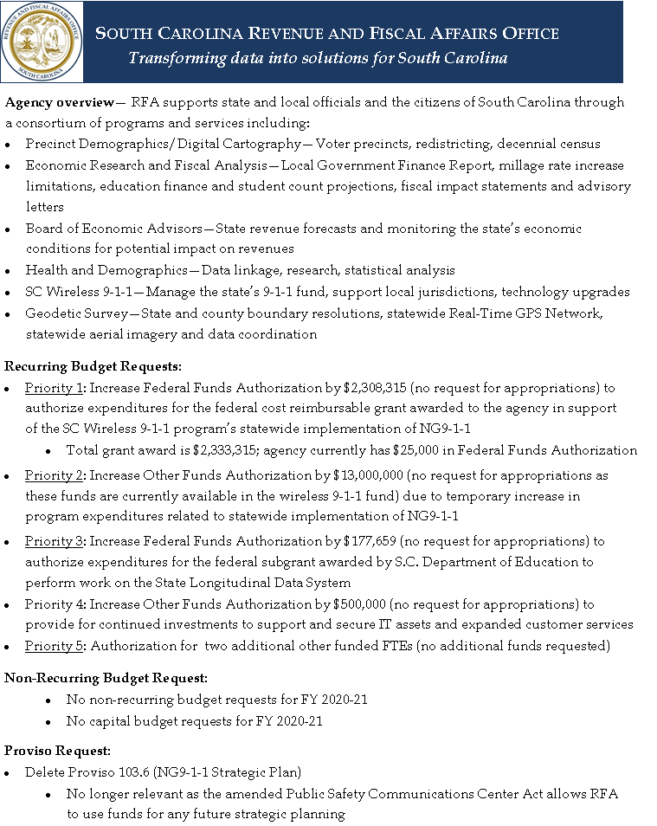

Slide 5
Accountability Report Summary
FY 2019-20 Accomplishments
  Statewide Aerial Imagery
  Successfully captured imagery for the entire state by March 2020
  Despite delays due to Covid-19, the quality control process should be complete by March 2021 in order to make the imagery available to state and local governments
  Obtained approximately 70% of the funding commitments required from state agencies, local governments, and other stakeholders to support ongoing costs and maintain the program
  NextGeneration (NG) 9-1-1
  Awarded contract to Comtech, Inc. to develop, implement, and transition the state’s 9-1-1 services to Next Generation technology
  The first group of eight local 9-1-1 call centers should transition to the new technology in the summer of 2021

Slide 6
Accountability Report Summary
FY 2019-20 Accomplishments
Safety, Integrity, and Security
Completed a third party risk assessment of IT infrastructure and internal processes
Implemented security action items for months one through six of the eighteen month roadmap
Feasibility Study for Coordinated System of Care
Assisted partners in a feasibility study for South Carolina to create and sustain a coordinated system of care for children from birth until the age of 5
Performed a gap analysis of data available to target and monitor programs and the calculated baselines for the program

Slide 7
Accountability Report Summary
FY 2019-20 Accomplishments
Education Funding Model
Released the Education Funding Model Report and presented to the Senate Education Funding Reform Study Committee, school superintendents, school business officials, a college sponsored conference on education funding, and one local school district
The premise of the model is that students drive the need for services, and different students may require different services
The model attempts to:
      identify those services,
      estimate the cost of providing them,
      emphasize equity, and
      ensure budgeting transparency
The intent is to provide a framework of financial data and inputs based upon current education expenditures and allow policy makers to evaluate the impact of system changes on funding needs

Slide 8
Accountability Report Summary
FY 2020-21 Goals
Deliver innovative, effective, and efficient customer service and information
Improve the delivery of information and services through investments and innovation
Ensure the security of our information technology infrastructure in order to protect the state’s information and resources
Promote a collaborative and knowledgeable work environment

Slide 9
FY2021-22 Budget Request Summary
FY 21-22 Budget Priorities Summary
Agency Name
Budget Priorities |  |  |  | Funding |  |  |  |  | FTEs
Priority No. | Priority Type (recurring/ non-recurring /other funds adjustment/ federal funds adjustment) | Priority Title | Priority Description | Recurring | Non - Recurring | Other | Federal | Total | State | Other | Federal | Total
1 | Federal Funds Adjustment | NG9-1-1 Grant | Federal cost reimbursable grant awarded through March 2022 for statewide transition to NG9-1-1 technology |  |  |  | 2,308,315 | 2,308,315 |  |  |  | 0
2 | Other Funds Adjustment | SC Wireless 9-1-1 Authorization | Temporary increase in the SC Wireless 9-1-1 program expenditures during the first three years' statewide implementation of NG9-1-1 technology |  |  | 13,000,000 |  | 13,000,000 |  |  |  | 0
3 | Federal Funds Adjustment | State Longitudinal Data System Grant (through DOE) | Federal subgrant awarded by SC Dept. of Education to RFA to perform work on the State Longitudinal Data System |  |  |  | 177,659 | 177,659 |  |  |  | 0
4 | Other Funds Adjustment | Expanded Program Services | Continued investments to support and secure IT assets and provide expanded customer services |  |  | 500,000 |  | 500,000 |  |  |  | 0
5 | Other Funds FTE Adjustment | Additional FTEs | Additional Other Fund FTEs (no funds requested) to allow flexibility in acquiring additional contractual work |  |  | 0 |  | 0 |  | 2 |  | 2

Slide 10
FY2021-22 Budget Request Summary
Recurring Budget Requests
No funds requested: Agency is only requesting authorization to spend existing other funds
Priority No. 1 and 2: Additional authorization (no funds requested) of $15,308,315 for the SC Wireless 9-1-1 Program
  Federal funds: $2,308,315 (NG9-1-1 grant)
  Other funds: $13,000,000 (temporarily increased to deal with NG9-1-1 implementation)
  Raising the authorization level for the wireless 9-1-1 program will ensure there is no delay in reimbursement to the PSAPs for their costs of implementing the NG9-1-1 program

Slide 11
FY2021-22 Budget Request Summary
Recurring Budget Requests (continued)
Priority 3: Additional authorization (no funds requested) of $177,659 for the State Longitudinal Data System grant
  Federal subgrant awarded by S.C. Department of Education to RFA to perform work on the State Longitudinal Data System
Priority No. 4: Additional other funds authorization (no additional funds requested) of $500,000 for expanded program services
  Raising authorization level will provide for continued investments to support and secure IT assets and expanded customer services
Priority No. 4: Authorization of two additional other funded FTEs
  No additional Funds Requested
  Allows flexibility in funding used for filling vacancies and taking on additional contractual work

Slide 12
FY2021-22 Budget Request Summary
Non-Recurring Budget Requests
None
Proviso Requests
Delete Proviso 103.6 (NG9-1-1 Strategic Plan
  No longer relevant as the amended Public Safety Communications Center Act allows RFA to use funds for any future plan

Slide 13
Cost Mitigation Due to Continuing Resolution
Agency was not impacted by the continuing resolution as no funds were requested in the previous budget submission

Slide 14
FY2021-22 Proviso Request Summary

Slide 15
All Agency Provisos

Slide 16
All Agency Provisos

Slide 17
All Agency Provisos

Slide 18
All Agency Provisos

Slide 19
Carryforward Balance
FM Budget vs Actual

Slide 20
FTE Breakdown

Slide 21
FTE Breakdown

Slide 22
Other Business
Non-Recurring Budget Appropriations Update
Thank you for the fulfilling the agency’s request for one-time appropriations (non-recurring funds) of $2,000,000 to establish a statewide aerial imagery program
Status Update
  Imagery captured for the entire state
  Should be available for use by March 2021 once the quality assurance process is complete
  Obtained approximately 70% of the funding commitments required from state agencies, local governments, and other stakeholders to support ongoing costs and maintain the program

Slide 23
South Carolina
Revenue And Fiscal Affairs Office
Thank you!
Our mission is to provide independent research, analysis, and resources to facilitate informed policy decisions and administration of services.

